Slide 1
ZeroR and OneR Classifier

Slide 2
Classifier (Recall)
Supervised learning contains (X, y)
X is the data comprising of instances with attributes <x₁, x₂, ….. x_{n}> (n featured attribute)
y is the label
If y is discrete/categorical, then the problem is a classification problem and we require a classifier to classify.
If y is continuous, then the problem is a regression problem

Slide 3
Categorical/Discrete variables
A categorical/ discrete variable is one that has two or more categories (values).
There are two kinds of categorical variable
Nominal
A nominal variable has no intrinsic ordering to the categories.
E.g., a gender is a categorical variable with values {Male, Female} that have no intrinsic ordering to the categories
Ordinal (related to order)
An ordinal data has clear ordering.
E.g., Temperature = {low, medium, high}

Slide 4
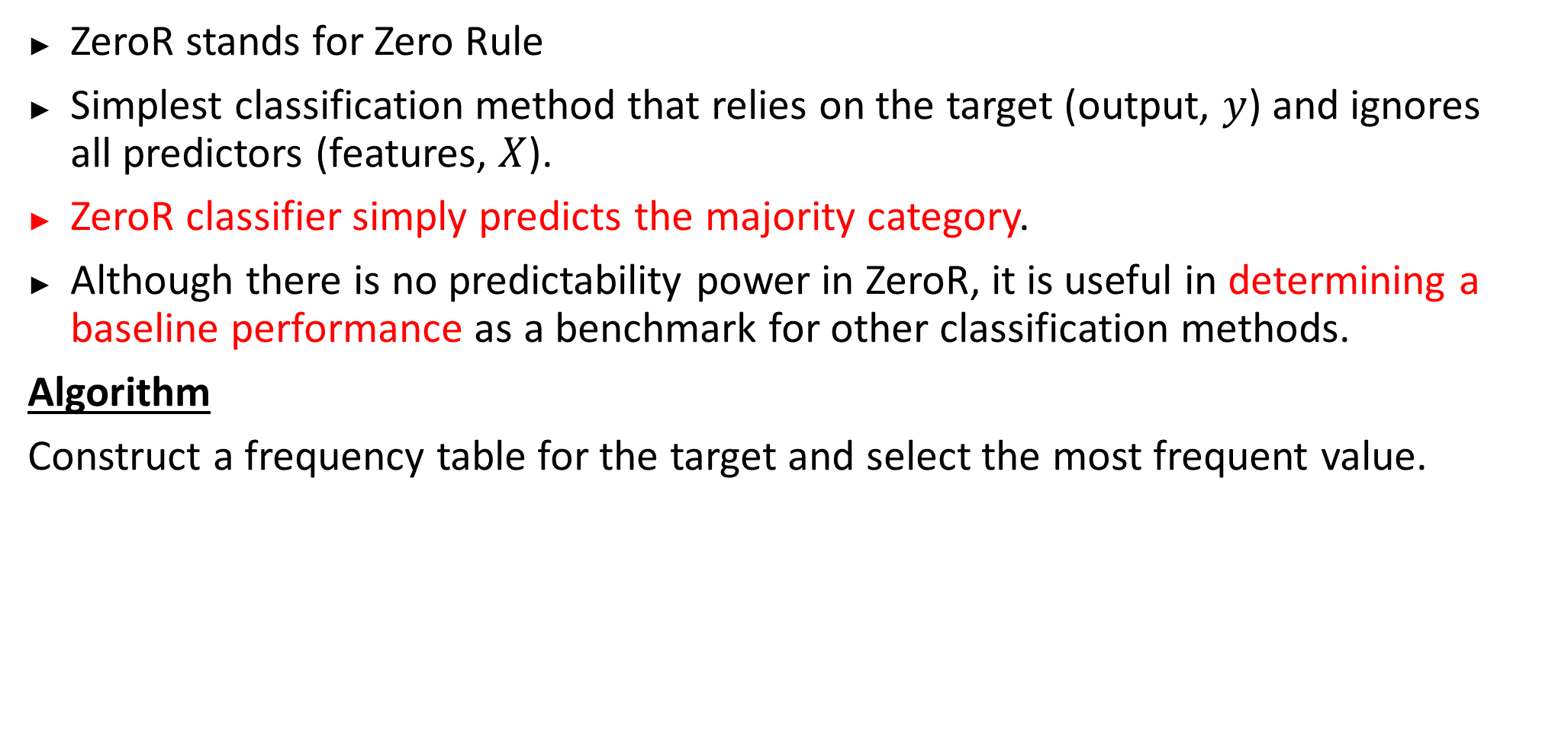
ZeroR classifier
ZeroR stands for Zero Rule
Simplest classification method that relies on the target (output, $y$) and ignores all predictors (features, $X$).
ZeroR classifier simply predicts the majority category.
Although there is no predictability power in ZeroR, it is useful in determining a baseline performance as a benchmark for other classification methods.
Algorithm
Construct a frequency table for the target and select the most frequent value.

Slide 5
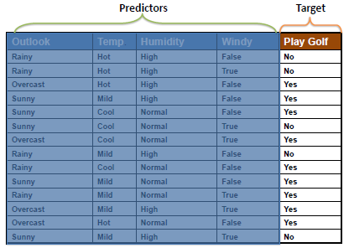
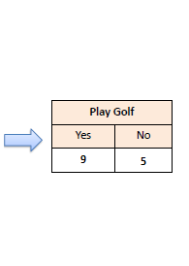
ZeroR classifier
For binary classification : Accuracy $≥50\%$
Can be tested for imbalanced dataset
Training accuracy = $\frac{9}{14}×100\%=64.3\%$
frequency table

Slide 6
Classification Model Evaluation
Models need to be evaluated and therefore some kind of model evaluation techniques need to be in place.
Confusion Matrix
A confusion matrix shows the number of correct and incorrect predictions made by the classification model compared to the actual outcomes (target value) in the data.
The matrix is N × N, where N is the number of classes in the target variable.
N = the number of classes

Slide 7
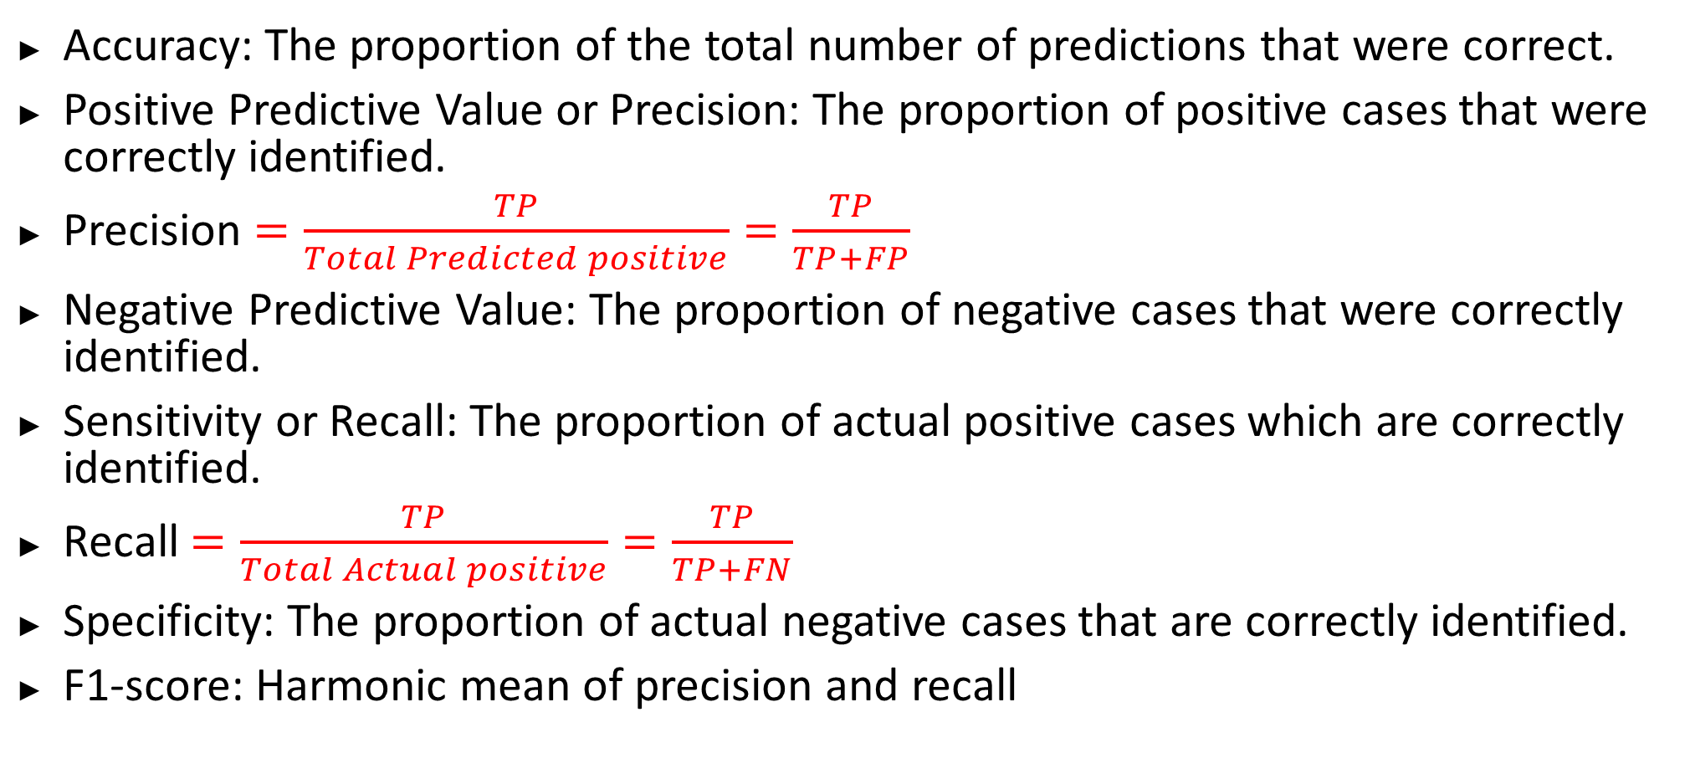
Terminologies (Related to Confusion Matrix)
Accuracy: The proportion of the total number of predictions that were correct.
Positive Predictive Value or Precision: The proportion of positive cases that were correctly identified.
Precision $=\frac{TP}{Total Predicted positive}=\frac{TP}{TP+FP}$
Negative Predictive Value: The proportion of negative cases that were correctly identified.
Sensitivity or Recall: The proportion of actual positive cases which are correctly identified.
Recall $=\frac{TP}{Total Actual positive}=\frac{TP}{TP+FN}$
Specificity: The proportion of actual negative cases that are correctly identified.
F1-score: Harmonic mean of precision and recall

Slide 8
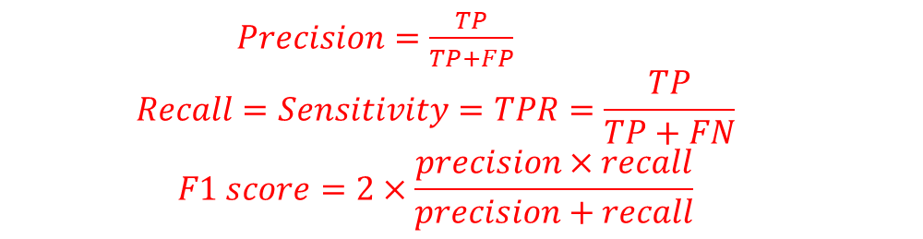
2 × 2 Confusion Matrix for two classes (Positive and Negative)
Confusion Matrix |  | Target (Actual)
 |  | Positive | Negative
Model (Predicted) | Positive | a (TP) | b (FP) | Positive Predicted value | a/(a+b)
 | Negative | c (FN) | d (TN) | Negative Predicted Value | d/(c+d)
 |  | Sensitivity | Specificity | Accuracy = (a+d)/(a+b+c+d)
 |  | a/(a+c) | d/(b+d)
$Precision=\frac{TP}{TP+FP}$
$$Recall=Sensitivity=TPR=\frac{TP}{TP+FN}$$
$$F1 score=2×\frac{precision×recall}{precision+recall}$$
a = True Positive (TP)
b = False Positive (FP)
c = False Negative (FN)
d = True Negative (TN)

Slide 9
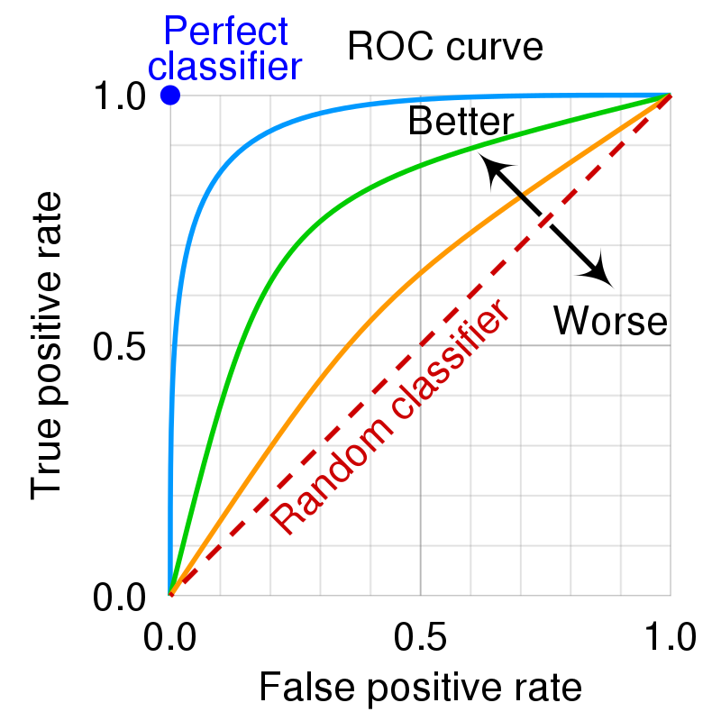

Precision-recall trade-Terminologies (Related to Confusion Matrix)off
Precision and recall: Important for imbalanced/skewed dataset
Cancer prediction, spam email prediction
TPR $=\frac{TP}{Total Actual positive}=\frac{TP}{TP+FN}$
FPR $=\frac{FP}{Total Actual negative}=\frac{FP}{FP+TN}$
ROC curve: TPR vs. FPR
AUC: Area under the ROC Curve
closer ROC AUC is to 1, the better.

Slide 10
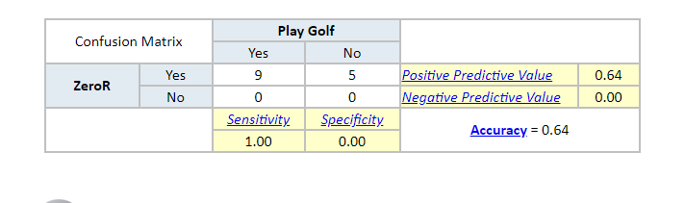
Confusion Matrix of the ZeroR Classifier for the “play golf” dataset

Slide 11
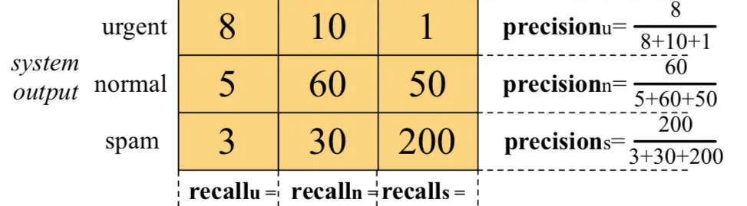
Confusion Matrix for multiclassification problem
Precision and recall for EACH class/category is calculated
Arithmetic/Macro average is calculated
Weighted average considers how many samples/instances of each class there were in its calculation, so fewer of one class means that it’s precision/recall/F1 score has less of an impact on their weighted average

Slide 12
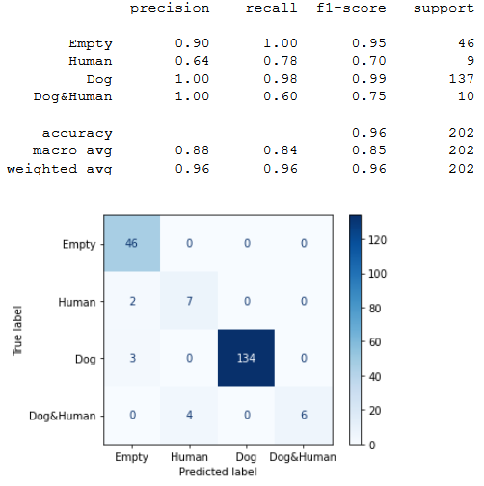
Confusion Matrix for multiclassification problem
Precision and recall for EACH class/category is calculated
Arithmetic/Macro average is calculated
Weighted average considers how many samples/instances of each class there were in its calculation, so fewer of one class means that it’s precision/recall/F1 score has less of an impact on their weighted average

Slide 13
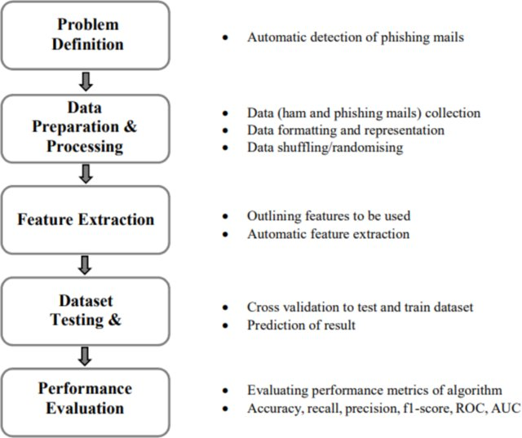
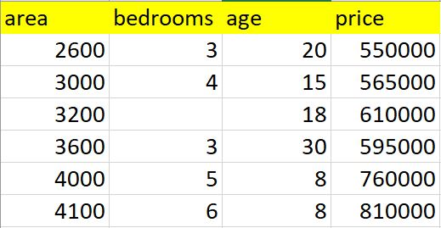
ML problem steps
EDA: Exploratory Data Analysis
Data Preprocessing: Remove duplicate and missing entries and incorrect data; outlier and noise detection
Outlier: data point that differs significantly from other observations
Label and One-hot encoding: Convert categorical values to numerical data
Feature scaling: standardize the independent features present in the data in a fixed range [0,1]
Hyperparameter optimization/tuning:
choosing a set of optimal hyperparameters
for a learning algorithm

Slide 14
ML library
WEKA: Machine Learning Software in Java
Contains tools for data preparation, classification, regression, clustering, association rules mining, and visualization
Developed at the University of Waikato, New Zealand
Anaconda: Anaconda is a distribution of the Python and R programming languages for scientific computing (data science, machine learning applications, large-scale data processing, predictive analytics, etc.), that aims to simplify package management and deployment
Anaconda Navigator is a desktop graphical user interface (GUI) included in Anaconda distribution that allows users to launch applications and manage conda packages, environments and channels without using command-line commands

Slide 15
WEKA
Weka is a collection of machine learning algorithms for data mining tasks.
It contains tools for data preparation, classification, regression, clustering, association rules mining, and visualization.
Weka supports deep learning!
Built in Java
Link: https://www.cs.waikato.ac.nz/ml/weka/

Slide 16
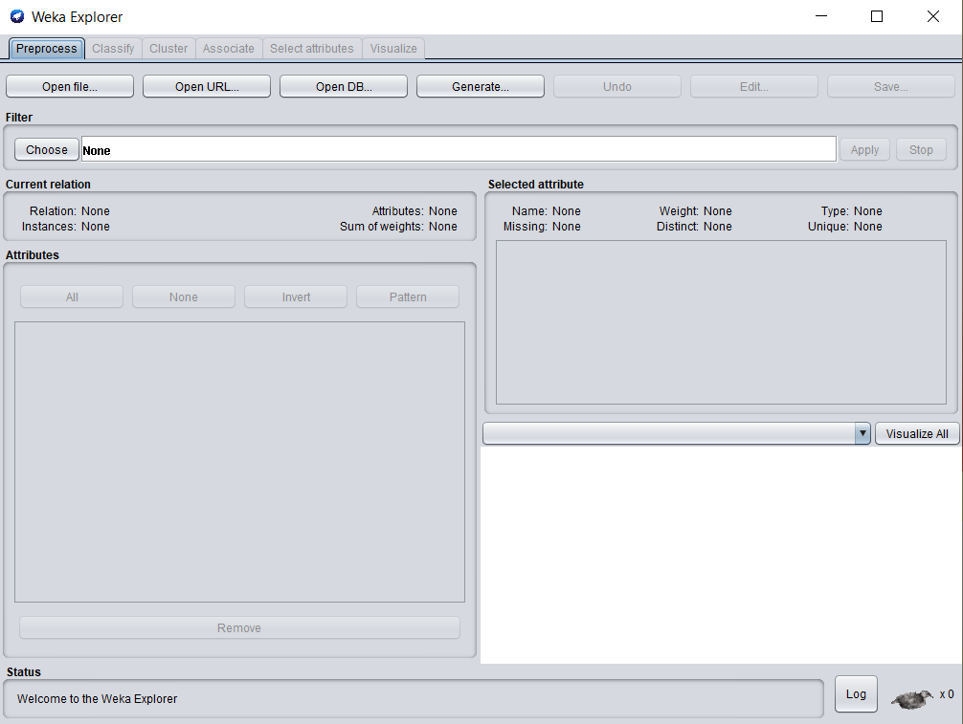

Weka Explorer

Slide 17
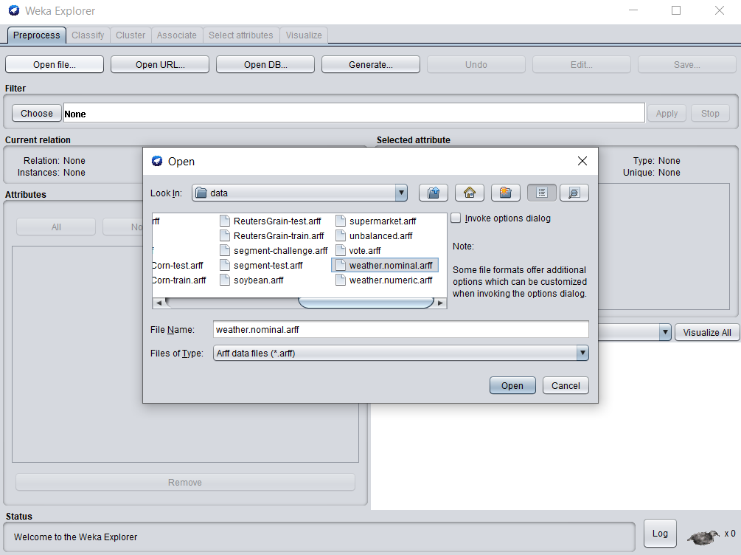
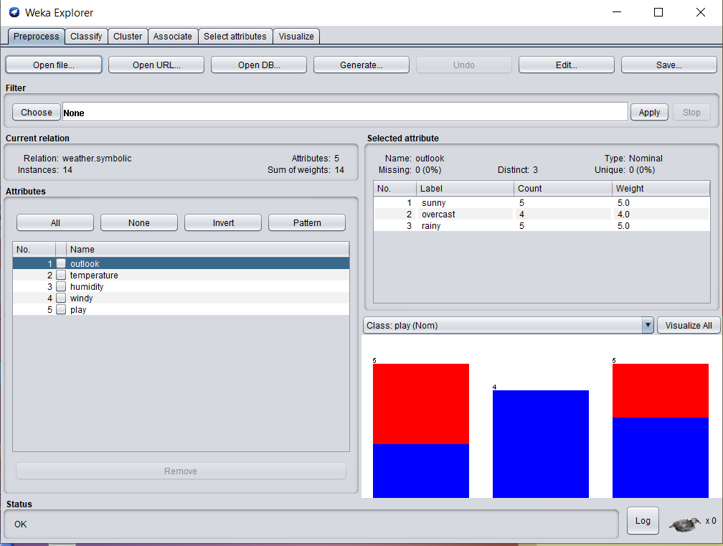
Weka File Selection

Slide 18
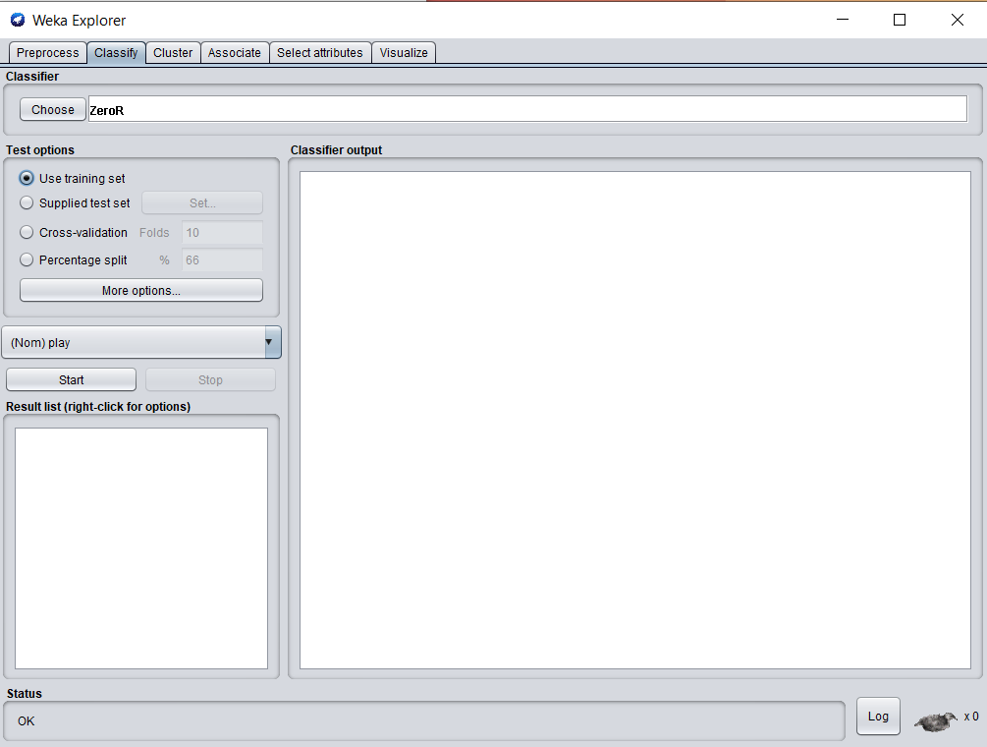
Weka

Slide 19
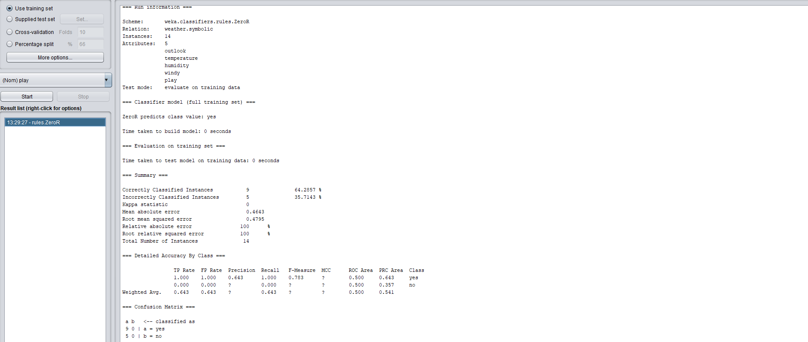
Weka Results

Slide 20
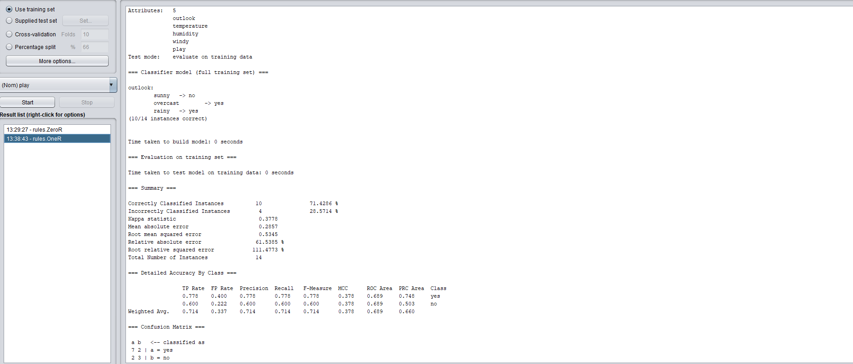
Weka Results

Slide 21
Anaconda libraries
Jupyter Notebook: Jupyter Notebook App is a server-client application that allows editing and running notebook documents via a web browser
Pandas: read, write data, data preprocessing – data handling
Matplotlib, seaborn: data visualization libraries
Sklearn (Scikit-learn): ML libraries
TensorFlow: library for machine learning and deep neural networks
Numpy: numerical Python. large, multi-dimensional arrays and matrices, along with a large collection of high-level mathematical functions to operate on these arrays
Change directory from Anaconda Prompt
Green: edit mode; Blue: Command mode

Slide 22
Google Colab
free cloud service hosted by Google that runs on cloud
Provides free GPU support
Kaggle: a subsidiary of Google LLC - online community of data scientists and machine learning practitioners.
Kaggle allows users to find and publish data sets, explore and build models in a web-based data-science environment, work with other data scientists and machine learning engineers, and enter competitions to solve data science challenges

Slide 23
OneR Classifier
OneR stands for “One Rule”
A simple, yet accurate, classification algorithm that generates one rule for each predictor in the data, then selects the rule with the smallest total error as its “one rule”.
OneR Algorithm:
For each predictor, For each value of that predictor, make a rule as follows; Count how often each value of target (class) appears Find the most frequent class Make the rule assign that class to this value of the predictor Calculate the total error of the rules of each predictor Choose the predictor with the smallest total error.

Slide 24
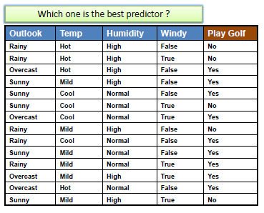
OneR classifier

Slide 25
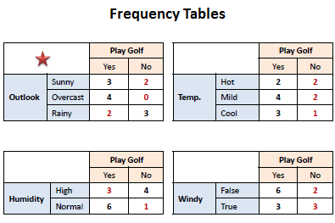
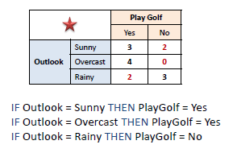
OneR classifier
Outlook_error = 2+0+2 =4; smallest error; Winning Predictor
Temp_error = 2+2+1 = 5
Humidity_error = 3 + 1 =4
Windy_error = 2+3=5

Slide 26
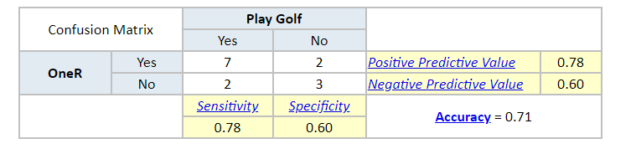
Model Evaluation (OneR classifier)
TP = 7
FP = 2
FN = 2
TN = 3

Slide 27
Machine learning in Python
Scikit-learn: Free, software machine learning library for Python programming language
Pandas: Software library written for Python programming language for data manipulation and analysis.
Matplotlib: A plotting library for Python programming language
Numpy: LIbrary for Python programming language which is used for working with arrays and matrices

Slide 28
ZeroR classifier using Python
imports
from sklearn.dummy import DummyClassifier
from sklearn.metrics import accuracy_score
from sklearn.metrics import confusion_matrix
from sklearn.metrics import classification_report
import pandas as pd

Slide 29
ZeroR classifier using Python
Reading dataset
df = pd.read_csv('E:\ML-teaching\Sample Datasets\weather.csv')
Try the following
print(df)
print(df.shape)
print(df.head())
print(df.describe())

Slide 30
ZeroR classifier using Python
Separate X and y
X = df.drop(columns = ['Play'])
y = df['Play']

Slide 31
ZeroR classifier using Python
Train and Test
model = DummyClassifier(strategy = 'most_frequent', random_state = 0)
model.fit(X,y)
predictions = model.predict(X)
score = accuracy_score(y, predictions)
print(score)
print(confusion_matrix(y, predictions))
print(classification_report(y, predictions))

Slide 32
Future
We should ideally divide the dataset into train set and test set
Train set should be used to create the model
Test set should be used to test how well the model is predicting unlabel cases.

